Slide 1


Using GraphQL APIs without a client library
Notes:
This lesson covers
Analyzing UI components to determine their GraphQL data requirements
Performing Ajax POST requests for GraphQL operations
Using tokens in request headers to identify the API consumer
Using fragments to make every UI component responsible for its own data requirements
Using GraphQL features to simplify and generalize the UI code
In the last lesson, we finished the implementation of the AZdev GraphQL API service. It’s now time to explore how to use that API practically in a frontend web application.
When it comes to using GraphQL in web applications, you can use it either directly with a simple Ajax library (like axios or fetch) or with a fully featured GraphQL client (like Relay or Apollo) to manage all GraphQL communications. We’ll explore using a GraphQL API with client libraries in the next lesson. In this lesson, we will start by exploring how to use the AZdev GraphQL API without a client library. However, to make this example as close as possible to a real-life project, we’re going to use a UI library to manage what happens in the browser.

Slide 2

Table of Contents
Using a web UI library
Running the web server
Making Ajax requests
Performing GraphQL query requests
Performing GraphQL mutation requests
Performing query requests scoped for a user

Slide 3
Using a web UI library
The most popular UI libraries today are Vue and React.
I’ll use React in this course because it’s closer to GraphQL’s ecosystem and design principles.
Besides the fact that both React and GraphQL originated at Facebook, React offers a language to declaratively describe user interfaces (web or otherwise), and GraphQL offers a language to declaratively describe data requirements
Notes:
I contemplated demonstrating how to use GraphQL without using a UI library (like React or Angular). While that would be a good exercise to learn the DOM API, it’s really not practical. For many reasons (beyond the scope of this course), no one builds frontend applications today without a UI library. It’s simply messy. UI libraries decrease the complexities of dealing with the DOM API and offer a declarative alternative to it. That is especially important if the web UI gets frequent UI updates.
React offers composability with its components, and GraphQL offers composability with its fragments. These similarities allow for a great match between React and GraphQL.
In addition, the most popular clients for GraphQL are designed for React first. You can certainly use some clients with other UI libraries, but their built-in support for React is first class. You can also use GraphQL in iOS and Android mobile applications with React Native.
If you don’t know React at all, it will not be a problem in this lesson. I’ll provide all the React-related code for the project. I also intentionally kept everything as simple as possible without making the example too trivial. I want you to focus on how GraphQL fits in a frontend application. Using a GraphQL API without a client in other UI libraries is very similar. You just need to find the points to hook GraphQL-related actions.

Slide 4
Table of Contents
Using a web UI library
Running the web server
Making Ajax requests
Performing GraphQL query requests
Performing GraphQL mutation requests
Performing query requests scoped for a user

Slide 5
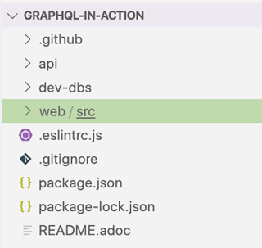
Running the web server
The api and web top-level directories
Notes:
If you’ve been following the code we wrote in part 2 of the course, you should have a Node web server running on port 4321 (by default) and serving a GraphQL API service on its root endpoint.
So far, we’ve been modifying files under the api directory in the course’s Git repository (available at az.dev/gia-repo). We’ll now start modifying the files under the web directory structure (figure).
NOTE
You need to have PostgreSQL and MongoDB both started and ready with the AZdev schema and have the API server running as well. See the instructions in the repo’s README file if you skipped over part 2 of the course.

Slide 6

Running the web server
With the database and API servers running, use the following command to run the web server.
$ npm run web-server
Notes:
This command will run a process that bundles all code and serves it on http://localhost:1234.

Slide 7
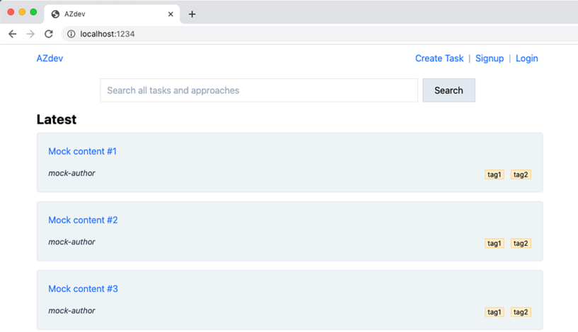
Running the web server
Notes:
If everything works okay, you should be able to access the development web server main page. It should look as shown in figure

Slide 8
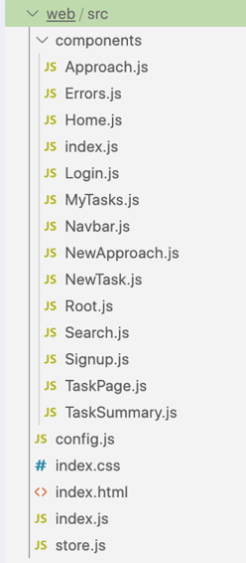
Running the web server
Take a look around the web directory and get familiar with its structure
Notes:
This is a pure React project that mounts a simple single-page app. There are no helper libraries like Redux or React Router. All React components are in web/src/components. The top-level component is Root, which is defined in web/src/components/Root.js. The components that can show up on their own in this example are exported in web/src/components/index.js. You can think of these components as the virtual pages of the app.
WARNING
The starting point for this lesson’s code will have a lot of ESLint errors because I left many unused variables in the template, and ESLint is configured to complain about that. We’ll use these variables when we need them. There should be no ESLint errors when we are finished with this lesson.
A React component is a basic JavaScript function that can optionally take arguments (known as props in React). It can have custom logic (like fetching data from an API), and it always returns a virtual DOM node. React takes care of mounting that virtual node in the right place and updates it (efficiently) when it needs to be updated. You can assume that the declarative state of that component will always be reflected in the browser. You just need to invoke JavaScript functions (which I have documented for you in the code) to get the DOM updated.
The state of this project’s UI is managed with a simple global context object. In React, a context object is global to the app that defines it, and every component in the tree can read it and modify it. The context object is defined in web/src/store.js. The two main things that are managed in the global context are the current component information (what component to render and what props to pass to it) and the current information of the logged-in user (if any). A few functions are defined on the context object and imported into the components that need them. For example, the useLocalAppState function can be used to read values from the app state, and the setLocalAppState function can be used to update the app state. These functions are defined on the context object because they need to access and modify the global app state.
MODULE BUNDLERS
All JavaScript code in this project gets bundled using Parcel. Parcel is a simple module bundler that can also compile special things like React’s JSX extension, modern JavaScript features, and even TypeScript. We’re using Parcel’s default configuration, which has hot module reloading configured out of the box. This will auto-refresh your browser session when you make changes to the code (and save them). Try that by changing the content of the mockTasks array in web/src/components/Home.js, and note that the browser auto-refreshes.
A couple of other popular module bundlers are Webpack and Rollup. Webpack, being the first, is more widely used. I’ve picked Parcel for this project for its simplicity and excellent default configurations. The official AZdev open source repository (az.dev/contribute) uses Webpack.

Slide 9
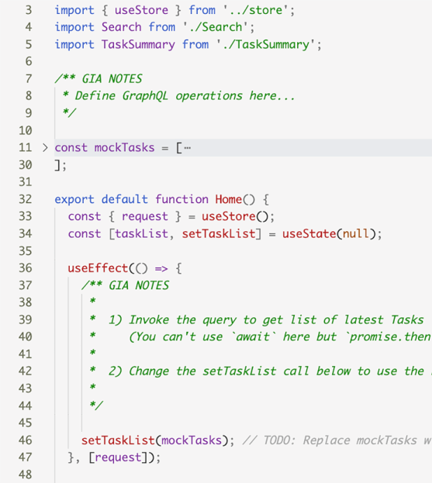
Running the web server
Notes:
We will be modifying almost every component file (under web/src/components) and the context object (in web/src/store.js), but you don’t need to create any new files in the project to follow this lesson. All the components are ready except where they require data reads and writes. You also don’t need to modify any of the components’ output (their returned JSX nodes). All the HTML work has been done, but it’s rendered with empty or mock data. We will modify the places in the code where these data variables are defined. In places where we need to make modifications, I have added notes in code comments (labeled “GIA NOTES”; see figure).
You also don’t need to modify any styling code or add any CSS classes to the HTML managed by React. The CSS is all wired and ready (in web/src/index.css), but it’s certainly not the best. I only made a few general style tweaks to make things look decent. The styles were based on the Tailwind CSS framework, but I extracted them out and made the project use them directly for simplicity.

Slide 10
Table of Contents
Using a web UI library
Running the web server
Making Ajax requests
Performing GraphQL query requests
Performing GraphQL mutation requests
Performing query requests scoped for a user

Slide 11
export default function Home() {
// ·-·-·
useEffect(() => {
request('{ currentTime }').then(({ data }) => {
console.log(`Server time is: ${data.currentTime}`);
});
// ·-·-·
}, [request]);
return (
// ·-·-·
);
}
Making Ajax requests
Notes:
To make a GraphQL request from a web application, we need to invoke an Ajax HTTP call. Remember that we made our GraphQL service available through HTTP POST requests.
Up to this point, we’ve been sending these POST requests through the GraphiQL editor. Under the hood, the GraphiQL editor issues Ajax calls in the background when you execute any document there.
Modern browsers have native APIs to make Ajax requests. For example, browsers today come with a built-in fetch method that can be used to invoke any type of HTTP Ajax requests. However, if you need to support older browsers, you cannot use fetch directly, but you can use a library that wraps the native API or polyfills it if it doesn’t exist. One common option is cross-fetch, as it will also allow you to do data fetching from Node.js; that’s something you’ll need if you plan to do any server-side rendering of your web applications. We’ll use it; it’s already part of this project’s dependencies.
Let’s do a test GraphQL request. Remember the currentTime field we started with back in lesson 5? Let’s make the app temporarily console.log it when it loads.
Make the following temporary code changes to the Home component (in web/src/ components/Home.js).
This code assumes that the already defined request function receives a GraphQL request text (like a query or mutation) and returns the GraphQL response object (which has data and errors attributes).

Slide 12
export const useStoreObject = () => {
// ·-·-·
const request = async (requestText, { variables } = {}) => {
const gsResp = await fetch(config.GRAPHQL_SERVER_URL, {
method: 'post',
headers: { 'Content-Type': 'application/json' },
body: JSON.stringify({ query: requestText, variables }),
}).then((response) => response.json());
return gsResp;
};
// ·-·-·
};
Making Ajax requests
Notes:
The request function’s skeleton is already defined in web/src/store.js. The function has to submit the Ajax POST request to the GraphQL service endpoint and return the response object. It needs to include requestText (its first argument) and any variables as well (second argument). Here’s a basic implementation.
If you’re using the default port for the GraphQL API service, you don’t need to do anything. If you used a different port, then you have to specify your new GRAPHQL_ SERVER_URL in the web/src/config.js file.
The code in listing 9.3 sends an Ajax POST request to the GraphQL service endpoint. The requestText argument, which is passed as { currentTime } from the Home component (listing 9.2), is sent as the query variable, which is the default variable that represents a GraphQL request text in the server HTTP handler (graphqlHTTP) that we defined in lesson 5.
TIP
This implementation of the request function is a simple happy path that expects a successful response. A more practical implementation will include error handling. I’ll leave the simple call here, as we’re going to replace this function in the next lesson.

Slide 13
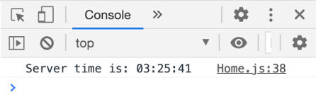
Making Ajax requests
You should now see the server time log message in your browser console
Notes:
Working with all GraphQL requests is really similar to this simple request. You make an Ajax request call, supplying a query or mutation operation text (and you include the variables that the operation uses). Then you do something with the resolved data response.
There are really no special tricks to using GraphQL directly without a client. You just need to make Ajax calls and handle their responses! However, there are some special tricks to organize your GraphQL client code in a readable and maintainable way. We’ll cover a few of them in this lesson.
Now that we know things are working well, remove the test request code we added in the Home component (in the useEffect function). Instead, let’s figure out the official data request (to fetch a list of the latest Task records) that we have to do in that useEffect function.

Slide 14
Table of Contents
Using a web UI library
Running the web server
Making Ajax requests
Performing GraphQL query requests
Performing GraphQL mutation requests
Performing query requests scoped for a user

Slide 15

Performing GraphQL query requests
{
id: 1,
content: 'Mock content #1',
author: { username: 'mock-author' },
tags: ['tag1', 'tag2'],
}
Notes:
The Home component is already wired to display a list of mock Task records in the UI. We now need to issue a GraphQL query that will get information from the GraphQL service about actual Task records and use the response data to replace the mock object.
The GraphQL root field we designed for this page is taskMainList. You can look at the code in web/src/components/Home.js to see what subfields must be included in this taskMainList query. The structure of the data required for this view is the same as that for the mockTasks object.

Slide 16

Performing GraphQL query requests
Relying on the structure of that object, here’s the GraphQL query required by the HOME component.
query taskMainList {
taskMainList {
id
content
author {
username
}
tags
}
}
Notes:
This taskMainList query does not need GraphQL variables. We can use its text directly in the request function.

Slide 17
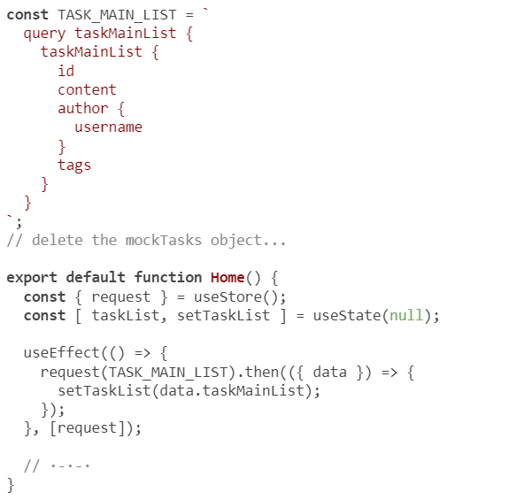
Performing GraphQL query requests
Notes:
it is a good practice to put the text of GraphQL operations next to the UI components that use them. Let’s do that.
We first define the query operation text (which I named TASK_MAIN_LIST to match what it returns). The all-uppercase naming convention is common but not required.
We then send that text to the GraphQL service (sometime in the life cycle of this component). When a successful response is returned, it will have a data property, which is an object that has a property for every root field in the query. We have only a single root field in this query (taskMainList). When we have the response (in the .then promise method), we make React aware of it (through the noted method). React will automatically update the browser’s DOM tree with the new data.

Slide 18
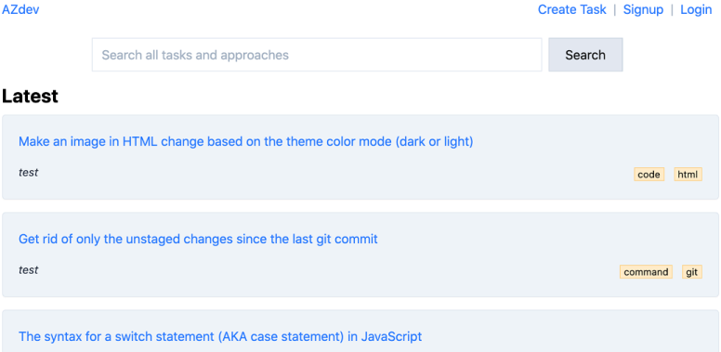
Performing GraphQL query requests
Notes:
In your browser, you should see the sample data Task entries listed with their author and tags information

Slide 19
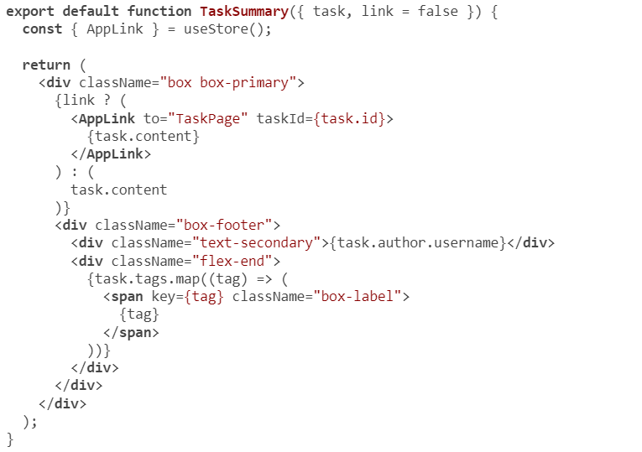
Using GraphQL fragments in UI components
Notes:
The mockTasks object in the Home component helps us easily figure out what GraphQL fields are required for that component. But what if we did not have that object? Also, what if we did not have the UI component? Is it better to start with a UI component or with a GraphQL query text?
The concept that helps me wrap my thoughts around these questions is one that we briefly touched on in previous lessons, but it’s now time to bring it to the forefront. I am talking about how every UI component (view) has specific data requirements and should be responsible for declaring those requirements. To figure out the data requirements of a view tree composed of multiple UI components, you put together the individual data requirements.
For example, the data from the taskMainList operation is actually used by two UI components: Home and TaskSummary. The view tree has only these two components, and each has its own data requirements. The Home component needs the id of a Task object. There is no mention of content, author.username, or tags in the Home component. These other fields come from the data requirements of the TaskSummary component, because that component is where they are used.
Take a look at the TaskSummary component (under web/src/components/ TaskSummary.js), and note the following (in bold).
Do you see the direct mapping between what variables are used in this component (the bold parts) and what GraphQL fields were included in the TASK_MAIN_LIST query in listing 9.6? We don’t have to rely on mock objects. We can use the component’s code to directly come up with its GraphQL data requirements. In fact, instead of putting the entire taskMainList query text in the Home component, let’s officially make every component declare its own data requirements. In most cases, one UI component does not care about the data requirements of its children, parents, or siblings.
This is where GraphQL fragments can play a role. We can make the TaskSummary component define a GraphQL fragment that declares that component’s exact data requirements and then make the Home component use that fragment to compose the main GraphQL query that’s needed to render the component (and its child component).

Slide 20
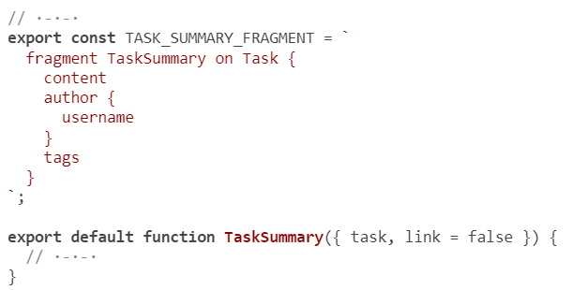

Using GraphQL fragments in UI components
Notes:
For example, we can define the following GraphQL fragment in the TaskSummary component.
This fragment simply represents the data required to display a TaskSummary component instance.

Slide 21
Using GraphQL fragments in UI components
// ·-·-·
import TaskSummary, { TASK_SUMMARY_FRAGMENT } from './TaskSummary';
const TASK_MAIN_LIST = `
query taskMainList {
taskMainList {
id
...TaskSummary
}
}
${TASK_SUMMARY_FRAGMENT}
`;
// ·-·-·
Notes:
Note that we exported this new constant so that other components can import and use it, which is what we now have to do in the Home component.
Isn’t this a beautiful abstraction?
Every component is responsible for its own part of a bigger data requirement. With this change, the Home component basically reaches out to its child (the TaskSummary component) and asks it, “What fields would you like me to fetch for you?”
Furthermore, with this structure, if the TaskSummary component is modified to require more (or fewer) fields from the API service, the Home component will not need any modifications.
This concept is often referred to as colocating fragments (or fields). Usually, the fields in a colocated fragment match the props of the colocated component. I think this is a good practice to follow, whether you use GraphQL directly (as in this example) or a GraphQL client, as we will see in the next lesson.
One trick to identify which UI components are candidates to define their own data fragments is to look at the components that are not rendered at the top level (directly by the Root component). For example, we cannot render a TaskSummary component on its own page. It’s always rendered by other pages (like Home, Search, and so on). This is similar to how we cannot invoke a GraphQL fragment on its own.
What other components are not rendered on their own in this example? If these components depend on their props to render their content, chances are they should have their own data fragments.
TIP
A child component can define multiple fragments and can also compose the fragments using subfragments of its own children components.

Slide 22
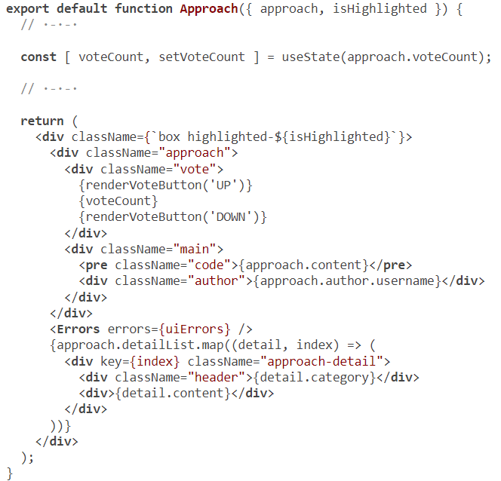
Including variables in requests
Notes:
The home page has a list of the latest Task records. The user can click a Task record to see its Detail page. The navigation is already implemented, but the data requirement for the page is not. Currently, when you navigate to a Task record page, you see mocked data.
We can display this page with the partial data that we’ve already fetched for a Task record through the taskMainList request (and then fetch the rest of the required data, like the list of Approaches). A featured client for GraphQL will do that automatically. It will cache any data it fetches from the server, and it will make partial data available. However, for our simplified example, let’s just issue a full request for this page. The component for this page is TaskPage (under web/src/components/TaskPage.js).
To determine what GraphQL fields are required for this new view tree, we need to look at the TaskPage component and all its children. It has two children components: TaskSummary and Approach.
We’ve already implemented the fragment for TaskSummary, and we can use it as is. The data requirements for a child component do not change based on which parent component renders it.
To complete the data requirements for the TaskPage component, we first have to come up with the data requirements for the Approach component, which renders a single Approach record (with all of its detail records).
Look at web/src/components/Approach.js, and find all the variables it uses to come up with a GraphQL fragment that matches these used variables.

Slide 23
// ·-·-·
export const APPROACH_FRAGMENT = `
fragment ApproachFragment on Approach {
content
voteCount
author {
username
}
detailList {
content
category
}
}
`;
// ·-·-·
Using GraphQL fragments in UI components
Notes:
Here’s the fragment I came up with for the Approach component
With fragments for both children components ready, we can now write the full data requirements for the TaskPage component.

Slide 24
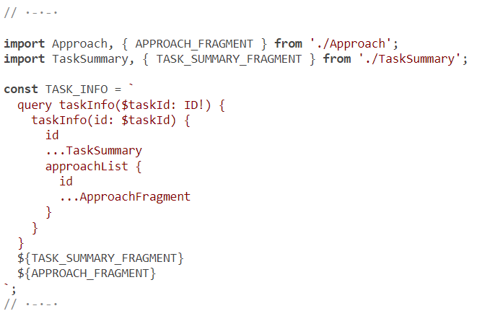
Using GraphQL fragments in UI components
Notes:
We can use the taskInfo root query field and include the approachList field in its sub-selection. This query will have to import and use the two fragments declared by the component’s children.
This query requires the use of a GraphQL variable ($taskId)

Slide 25
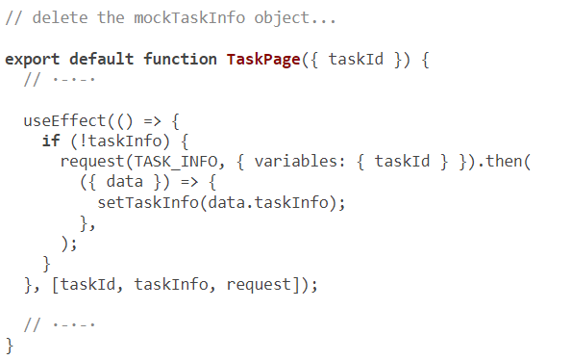
Using GraphQL fragments in UI components
Notes:
We can issue the data request where noted in the component’s code and pass the taskId variable as part of the second argument to the request function.

Slide 26
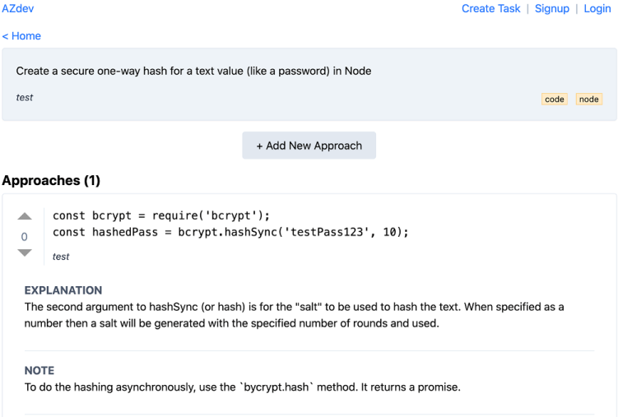
Using GraphQL fragments in UI components
Notes:
When you navigate to a Task page now, all the data for the Task record, its list of Approach records, and the Detail list for each Approach should be fetched (with one GraphQL request) and displayed properly in the UI
So far, we’ve implemented read-only query operations. Let’s now take a look at how to invoke mutation requests. Spoiler alert: it’s not that different.

Slide 27
Table of Contents
Using a web UI library
Running the web server
Making Ajax requests
Performing GraphQL query requests
Performing GraphQL mutation requests
Performing query requests scoped for a user

Slide 28
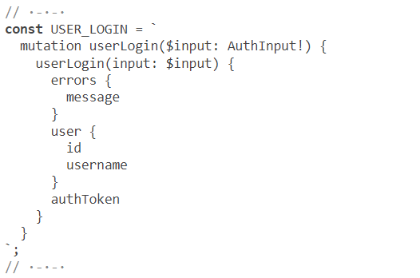
Performing GraphQL mutation requests
The login/signup forms
Notes:
A GraphQL mutation is usually invoked as part of an onSubmit event in an HTML form. The mutation input is generally read from the HTML form elements (text input, select value, check box, and so on).
We have five basic forms in this project: login, signup, create Task, add an Approach to a Task, and search all Tasks and Approaches. Each of these forms will invoke a single mutation.
Sometimes mutations are invoked with a simple onClick event without any input elements in a form. An example is the vote-on-Approach feature.
Some mutations can be invoked publicly without the scope of a logged-in user account. Examples include the mutations to create a new user account and log in an existing user account. We also kept the vote-on-Approach mutation public.
Some mutations require the scope of a logged-in user account. For example, only logged-in users can create Task/Approach records.
Some mutations can be invoked publicly, but they behave differently if invoked with the scope of a logged-in user. An example is the search mutation, which includes private Task records that belong to the user who is making the search. It will only include public records when invoked without an authenticated user scope.
Let’s start with the userLogin and userCreate mutations. They can be invoked without including any authentication headers, and they both return an active authToken value that can be used with the other mutations.
You can get to the login/signup forms using the links in the top-right corner of the home page. The components used for these pages are as follows:
The Login component is under web/src/components/Login.js.
The Signup component is under web/src/components/Signup.js.
These components display simple HTML forms with submit buttons. Our task is to implement their onSubmit event handlers. These handlers are pretty much the same in both components. They have to read the mutations’ input object from the form elements, submit the mutation request, and then store the user record on the global state of the app so that they can navigate to other pages and submit other mutations.
Here’s the mutation operation that can be used to log in a user using their username/ password. Put this in the Login component.

Slide 29

// ·-·-·
const USER_CREATE = `
mutation userCreate($input: UserInput!) {
userCreate(input: $input) {
errors {
message
}
user {
id
username
}
authToken
}
}
`;
// ·-·-·
The login/signup forms
Notes:
Here’s the mutation operation that can be used to create a new user account. Put it in the Signup component.
We’ve seen and tested these mutations directly in GraphiQL before, but now we will invoke them in submit handlers within components.

Slide 30
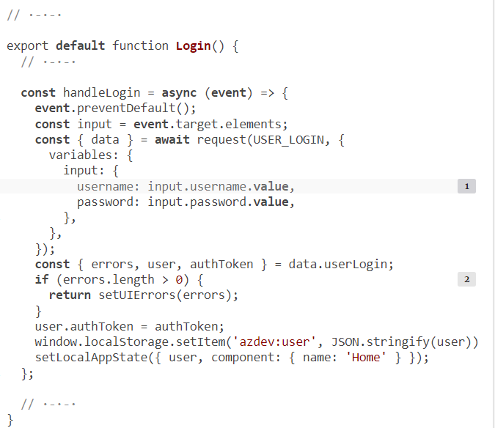
The login/signup forms
Notes:
In the Login component, we invoke the request function using the USER_LOGIN mutation after capturing its input from the form elements. Here’s one way to do that.

Slide 31
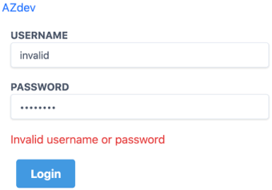
The login/signup forms
Test the Login form with invalid credentials.
You should see the “Invalid username or password” message

Slide 32
The login/signup forms
To test the Login form with valid credentials, use the test account in the sample data script (test/123456).
You should be redirected to the home page, and the navigation bar should now display the user’s username
Notes:
To invoke the userCreate mutation, we have to read the values of firstName, lastName, username, and password. The form also has a confirmPassword field, but the GraphQL API we implemented for this mutation does not support it. This is an example of a validation check that we can do before allowing a GraphQL mutation operation to go through.
PERSISTING USER SESSIONS
The code as of now will persist the user session with localStorage. This is a simple example of the persistent caching of an element from the local app state. This is different from caching API data (which we’re not doing yet in this example). An example of API data caching would be to not fetch the taskMainList array again when you navigate away from the home page and then navigate back to it. In the next lesson, we will see how a GraphQL client library seamlessly performs API data caching when it can.
There is more to persisting user sessions than using a simple localStorage record, but that is beyond the scope of the course. You can check out the official AZdev project (at az.dev/contribute) to see how we do session persistence for the project.

Slide 33
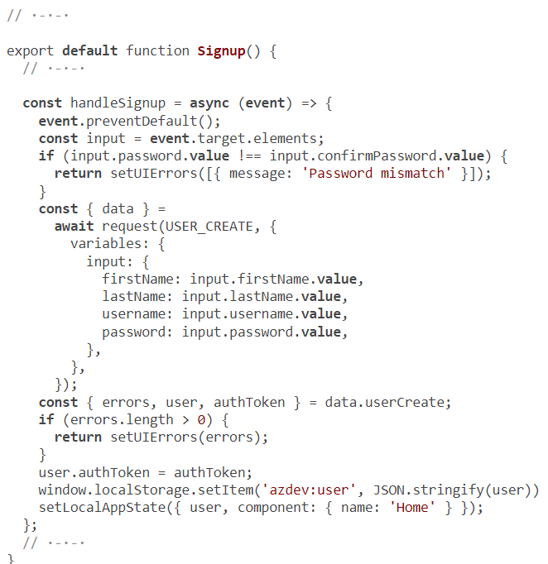
Implemented Of mutation call.
Notes:
You can test the signup form now. You should be able to create a new user account, and you should be logged in after you do.

Slide 34
Authenticating GraphQL requests
const request = async (requestText, { variables } = {}) => {
const headers = state.user
? { Authorization: 'Bearer ' + state.user.authToken }
: {};
const gsResp = await fetch(config.GRAPHQL_SERVER_URL, {
method: 'post',
headers: { ...headers, 'Content-Type': 'application/json' },
body: JSON.stringify({ query: requestText, variables }),
}).then((response) => response.json());
return gsResp;
};
Notes:
We can simply include that authToken value (if one exists) as part of any GraphQL request we send to the API service and let the API service determine whether to use it or ignore it. To do that, we have to modify the request function and include the AuthorizationBearer token. For the fetch function, this is done through the headers property that’s part of the third argument.

Slide 35
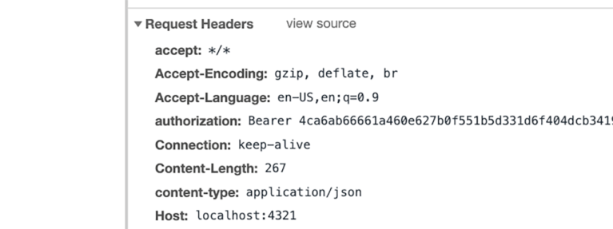
Authenticating GraphQL requests
Notes:
Now, when a user is logged in, all GraphQL requests will include their current authToken value, and they can invoke the mutations that depend on it. You can verify that by inspecting the headers of any XHR request in the Network tab in your dev tools

Slide 36
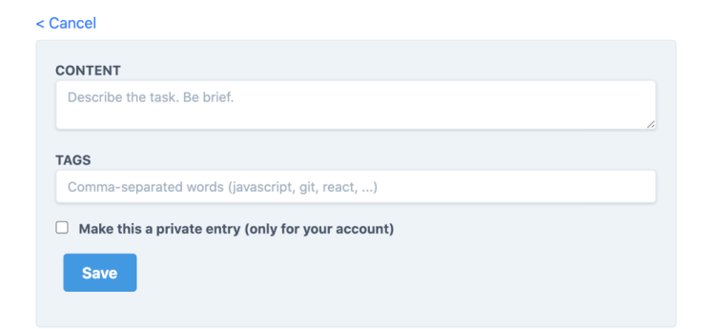
The Create Task form
Notes:
Now that users can log in and their authToken value is included in the headers of all GraphQL operations, we can have users create a new Task record. The HTML form to do so can be reached by clicking the Create Task link in the top-right corner
The component that renders this HTML form is under web/src/components/ NewTask.js. The form has three elements: the content box, the tags text box, and the public/private check box.
These three input elements match the TaskInput type structure that can be used with the taskCreate mutation field. However, we have to send the tags input value as an array of strings rather than one string. We can use a .split(',') call on the input text value to do so.
When a Task object is created successfully, we can use the commented out setLocalAppState call to navigate the user to the page of that newly created Task object.

Slide 37
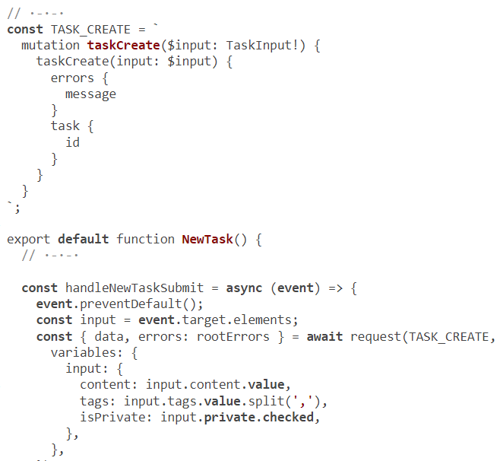
The Create Task form
Notes:
Here’s the implementation I came up with for this component.

Slide 38
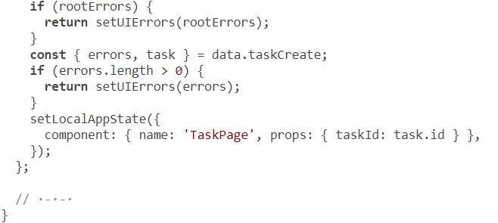
Continued code
Notes:
As a logged-in user, you should now be able to create your own Task records.
Before we implement the next mutation, let me tell you about a good chance to optimize the UI that handles this mutation. Right now, the code makes one GraphQL mutation request to create a Task object. It then navigates the user to the Task page and makes another GraphQL query request to read the data for that new Task object. You can verify that in the Networks tab in your browser’s dev tools.
However, we can skip the second request (to fetch the data in the Task page) because that same data can be read in full as part of the mutation request. To do that, we have to make the taskCreate mutation ask for all the data required to render the TaskPage view.
This means the TaskPage component should declare its full data requirements as a fragment (even though it’s a top-level component).

Slide 39
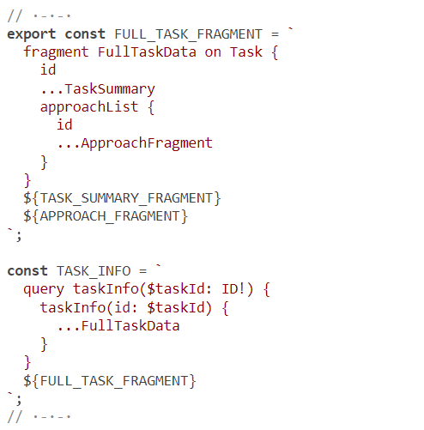
The Create Task form
Notes:
In the TaskPage component, refactor the TASK_INFO query to use a fragment and export that fragment for others to use it. Let’s name the fragment FullTaskData.

Slide 40

// ·-·-·
import { FULL_TASK_FRAGMENT } from './TaskPage';
const TASK_CREATE = `
mutation taskCreate($input: TaskInput!) {
taskCreate(input: $input) {
errors {
message
}
task {
id
...FullTaskData
}
}
}
${FULL_TASK_FRAGMENT}
`;
// ·-·-·
The Create Task form
Notes:
modify the taskCreate mutation to ask for all the data required by TaskPage.
To optimize the UI of the TaskPage component to not do the extra fetch, we have to change that component to accept an optional data object (instead of just an ID), check for it before the TASK_INFO query, and only perform that request if the object does not exist. This is a React-only change, so I’ll skip it here. It’s a good practice to always fetch all the data the UI would need to handle the creation of any object, even if the UI discards it at first (and fetches it again). As we transition into a more featured client for GraphQL requests, caching and optimizing requests will be managed for us by that client.

Slide 41
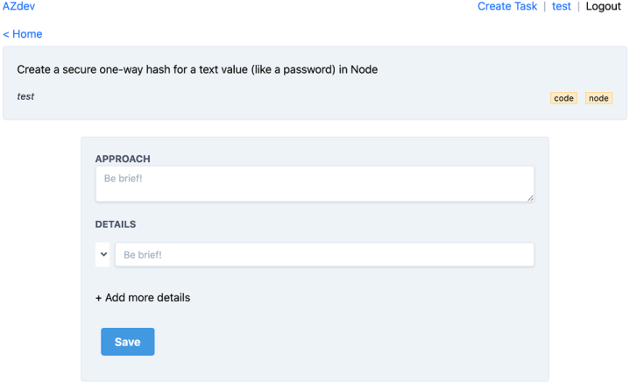
The Create Approach form
Notes:
Next up, let’s implement the mutation to add an Approach record to an existing Task record. You need to be logged in first to access the UI form for this feature. While looking at a Task page, click the Add New Approach button. You should see the Create Approach form
One challenge I prepared for this form is the Details category selector. Remember that an Approach Detail can be a Note, an Explanation, or a Warning; but I did not hardcode these values in the HTML form (the HTML select element is empty in figure).

Slide 42

The Create Approach form
// ·-·-·
const DETAIL_CATEGORIES = `
query getDetailCategories {
detailCategories: __type(name: "ApproachDetailCategory") {
enumValues {
name
}
}
}
`;
// ·-·-·
Notes:
What if the GraphQL service adds a new category (or removes one) in the future? Is there a way to future-proof this HTML form?
Yes! This is where you’re going to appreciate GraphQL’s introspective queries. We can ask the GraphQL service what values it supports in the ApproachDetailCategory type using the __type introspective field.
Then, we can use the response to build the HTML form

Slide 43
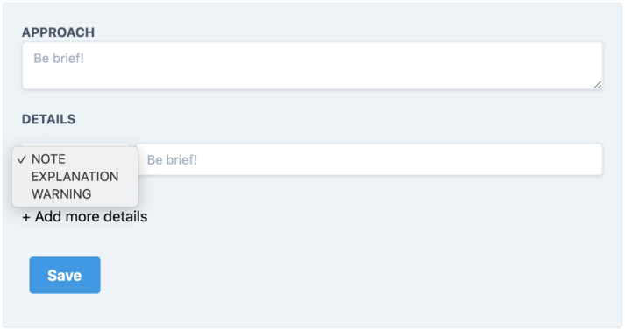
The Create Approach form
// ·-·-·
export default function NewApproach({ taskId, onSuccess }) {
// ·-·-·
useEffect(() => {
if (detailCategories.length === 0) {
request(DETAIL_CATEGORIES).then(({ data }) => {
setDetailCategories(data.detailCategories.enumValues);
});
}
}, [detailCategories, request]);
// ·-·-·
}
Notes:
The React UI code to do that is already implemented, but we have to make the request for this introspective query somewhere. For example, we can make it every time this form is rendered. That’s what I prepared in the code. Here’s how to do it.
This should make the values supported by the server appear in the HTML form
TIP
This type of request should be cached and not invoked every time a user renders the HTML form. These categories will not change that frequently. I would even cache this particular request server-side.

Slide 44
// ·-·-·
import { APPROACH_FRAGMENT } from './Approach';
// ·-·-·
const APPROACH_CREATE = `
mutation approachCreate($taskId: ID!, $input: ApproachInput!) {
approachCreate(taskId: $taskId, input: $input) {
errors {
message
}
approach {
id
...ApproachFragment
}
}
}
${APPROACH_FRAGMENT}
`;
// ·-·-·
The Create Approach form
Notes:
Now that the HTML form is ready, let’s figure out how to make the approachCreate mutation work with it. That mutation takes a taskId variable and an ApproachInput object. In its returned data, we can ask for the details of the newly created Approach record. The exact fields that we have to include in the output of this mutation are what the UI requires to render an Approach record. We’ve already created a fragment in the Approach component to represent these fields. We can just reuse it here.
The input to this mutation is a bit special because of the detailList part, which has to be an array of objects (where each represents one detail record).

Slide 45
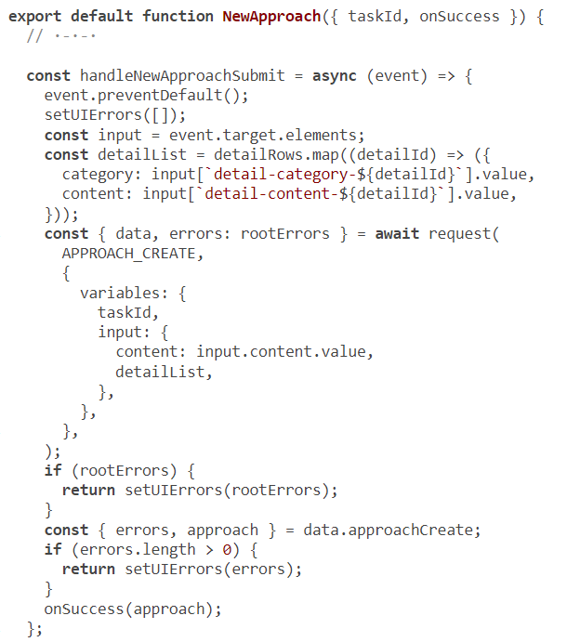
The Create Approach form
Notes:
Once the mutation is successful, we can call the noted onSuccess method, passing the data returned by the mutation for the new Approach record. The logic of the onSuccess function here is all React, but it basically updates the UI with the newly created Approach record (and highlights it as well).
Here’s the implementation I came up with for this handler.

Slide 46
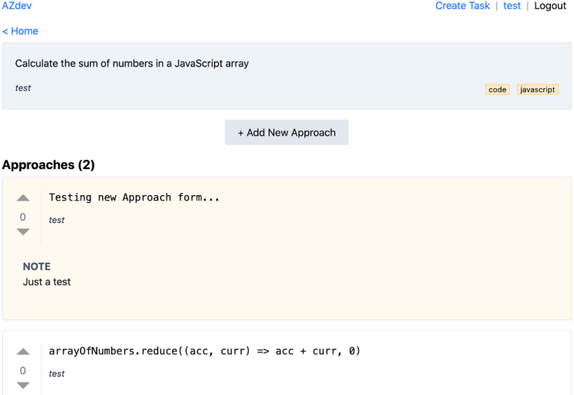
The Create Approach form
Notes:
You can test adding a new Approach entry to a Task entry. The new Approach should appear on top with a slight background highlight

Slide 47
Table of Contents
Using a web UI library
Running the web server
Making Ajax requests
Performing GraphQL query requests
Performing GraphQL mutation requests
Performing query requests scoped for a user

Slide 48
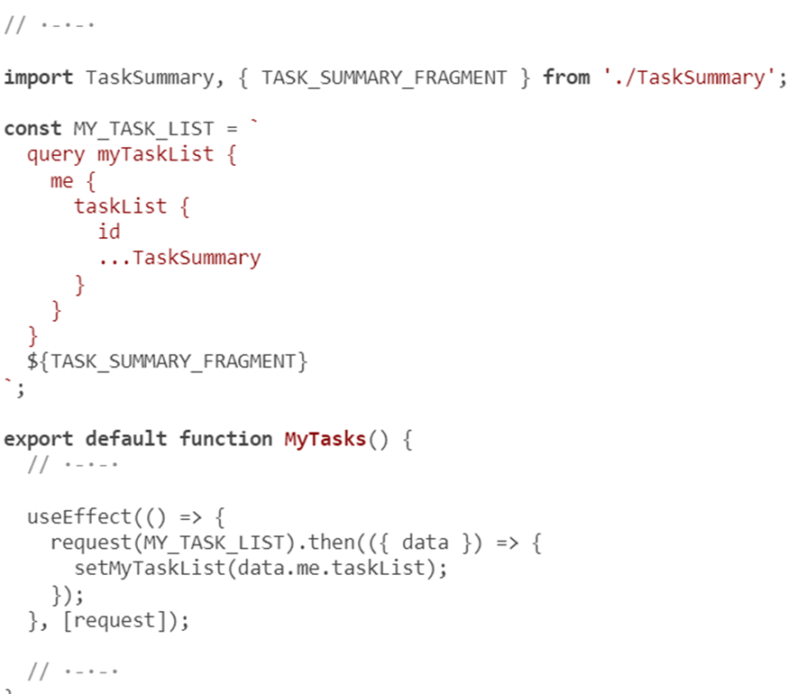
performing query requests scoped for a user
Notes:
As a logged-in user, you can click your username link in the top-right corner to navigate to a page that should list all the Task records you have created (including private ones). This page is similar to the home page, but the GraphQL query it requires is different. This one has to use the me root field and ask for the taskList field under it. It can reuse the TaskSummary fragment just as the home page did.
Try to do this on your own as well. The component that you have to change is MyTasks under web/src/components/MyTasks.js. Here’s how I implemented it.

Slide 49
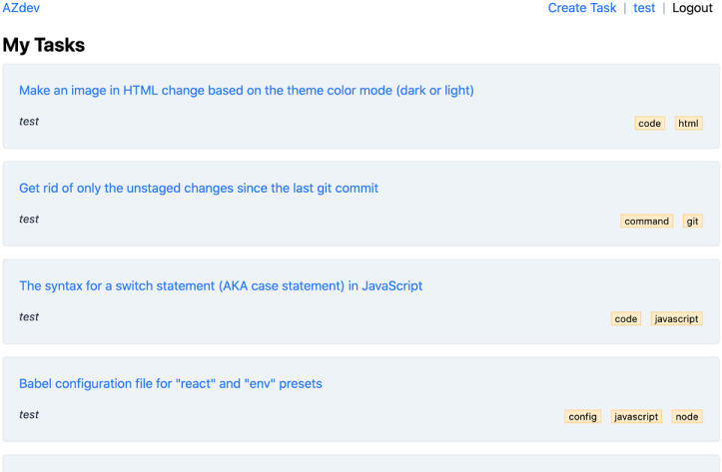
performing query requests scoped for a user
Notes:
We don’t need to do anything special for this query because we’re already sending the current user’s authToken value with every GraphQL request. The server uses that value to authenticate the request and return the data for the user who is making it. Log in with test/123456, and click the username link in the navigation bar to test the user’s Task-list feature

Slide 50
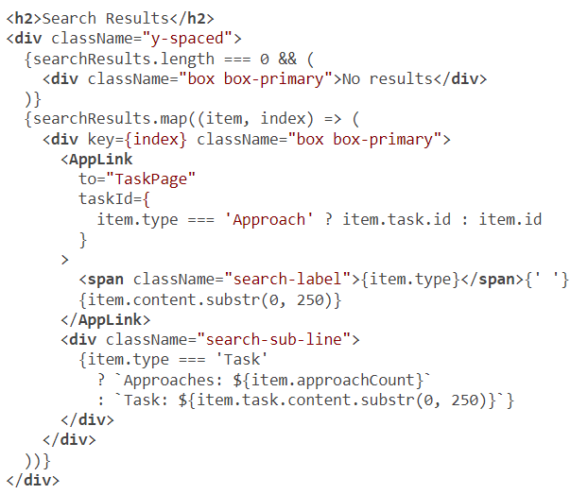
The Search form
Notes:
The search feature is probably the most important feature in the AZdev application. It will be heavily used because it’s the entry point for all Task records.
It’s also special because it should work with or without a user session. Without a user session, the API we implemented will exclude all private Task records. By including an authToken, the API will include the private Task records owned by an authenticated user. This is why I kept this feature for last so that we can test these two branches from the UI.
The root GraphQL field that we can use is search. We’ll alias it as searchResults. It expects a term string as its only argument. That string is what we need to read from the search input text box. However, the UI is designed such that the state of the component changes when a user clicks the Search button, and the search-term value can be read from the local app state. That part is already implemented in the code.
Another special thing about the search query is how it represents two API object types. Search results can include both Task and Approach records. The UI is implemented to display these types differently (based on a .type attribute). Look at the JSX in web/src/components/Search.js to analyze what fields this search query requires (by looking at used variables):
The bold parts on each search item tell us that we need the following fields: type, id, content, approachCount (if it’s a Task), and task.content and task.id (if it’s an Approach). We made the search root field an interface implemented by both Task and Approach models. This means the __typename introspective field will hold the value of Task or Approach. We’ll have to alias that as type since that’s what the UI is using.

Slide 51
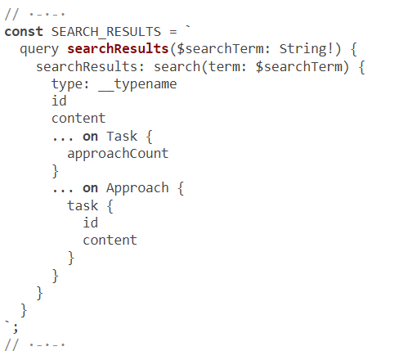
The Search form
Notes:
The content field can be read directly under the search field because it is common in both types. However, both the approachCount and task fields will have to be included conditionally using inline fragments. Here’s the query I came up with after this analysis.

Slide 52
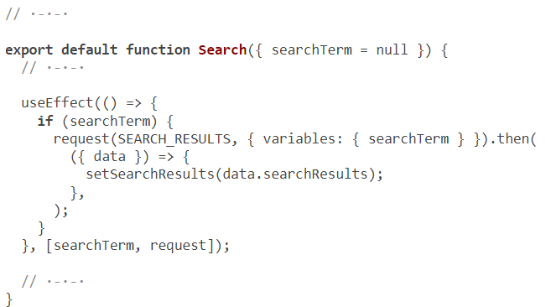
how I invoked the searchResults query.
Notes:
The content field can be read directly under the search field because it is common in both types. However, both the approachCount and task fields will have to be included conditionally using inline fragments. Here’s the query I came up with after this analysis.

Slide 53
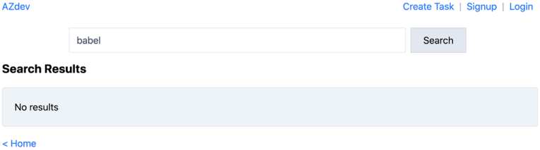
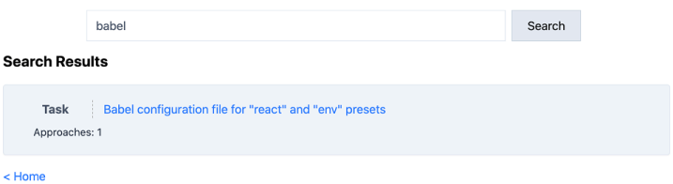
Search form
Notes:
You can test the Search form now. Make sure it works for both Task and Approach content. Also test the public/private feature. If you create a private Task entry, it should only be included in search results when you’re logged in. The sample data has a private entry owned by the “test” user. Test searching for “babel” as a guest and as the “test” sample data user
Next up
We have skipped many complexities in this lesson. While some simple applications will not need to worry about such complexities, most will. You should be aware of them in all cases. For example, what if the API service takes too long to reply? What if it’s down? What if it returns partial data with errors?
In each of these situations, the UI should behave in a user-friendly way. It might need to retry a request, display a global error message, or display a warning to tell the user that a request is taking longer than usual.
The complexities are on both ends of this stack. The browser has many limitations. What if it cannot allocate more memory? What if it has a limited network or CPU power? There is a lot we can do to make this application a bit more usable on slow and restricted devices. Just as we used DataLoader to cache and batch SQL operations, we can use a specialized GraphQL client library to cache and batch GraphQL operations.
Here are a few generic considerations when deciding whether to use a client library like Apollo or Relay. These libraries greatly simplify things like the following:
Performance-For example, caching responses and batching multiple network requests into one. Also, displaying a big list of records using pagination, to avoid overwhelming the app memory.
Efficiency-For example, asking servers for only the new data required by a view and then merging new data with old data; or asking servers for only the data used in the visible window and asking for the rest of the data as the user scrolls up or down.
Dealing with failure-For example, employing standard error-handling for failing requests and a standard retry strategy.
Responsiveness-For example, showing expected data changes optimistically while waiting on a confirmation from the server. Then, possibly performing a rollback on those optimistic changes if the server fails to persist the data.
Cache management-For example, deciding what to cache, where to cache it, and when to expire something in the cache.
These factors are why specialized frontend GraphQL client libraries exist. In the next lesson, we will explore one of the most popular GraphQL clients today: the Apollo Client.

Slide 54
Summary
Components can define operations and fragments.
An operation can be a query, a mutation, or a subscription.
A component query operation is generally used to display that component.
A mutation operation is usually used within a DOM event handler (like onSubmit or onClick)
Notes:
To use a GraphQL operation in a frontend web application, you need to make Ajax calls. These calls usually cause the UI state to change. You’ll have to make them in a place where it’s
A subscription operation is generally used to autoupdate a frequently changed view.
Fragments allow components to be responsible for their own data requirements. Parent components can use these fragments to include the data required by their children components.
Mutation operations usually require the reading of input element values. The structure of a UI form should match the structure of the mutation input type.
GraphQL introspective queries can be used to future-proof parts of the UI that depend on dynamic values.

Slide 55

"Complete Lab"

